Slide 1
Creation of Multi-Jurisdictional Transportation Development District
March 2024
Presented by Robert Klahr, Armstrong Teasdale
rklahr@atllp.com, 314-552-6683

Slide 2
Creation of Multi-Jurisdictional Transportation Development District
Mayors of the 24:1 Municipal Partnership desire to
Create an additional revenue stream for capital improvements
Pool resources to address transportation needs, including ongoing maintenance, capital improvements and special projects
Create a legal governing body for the Partnership
Creation of a Multi-Jurisdictional Transportation Development District or “TDD,” a political subdivision of the State, will accomplish these goals.
Formation - Petition to the St. Louis County Circuit Court
Filed by 2 or more municipalities within the 24:1 Municipal Partnership
TDD boundaries include all property within the participating municipalities (must be contiguous)
Election of registered voters within the TDD is required

Slide 3
Multi-Jurisdictional TDD
New Revenue Source - Sales Tax of up to 1%
What can a TDD pay for?
Bridge, street, road, highway, access road, interchange, intersection, signing, signalization
Sidewalks, streetscape
Parking lot, garage
Bus stop, light rail, or other mass transit
Personnel assigned to transportation-related projects
TDD governed by a Board of Directors comprised of presiding officer of each participating municipality (e.g., mayor or village chair)
Notes:
From Rob: A TDD can pay for personnel that are assigned to transportation-related projects. St. Ann is using its joint TDD with Bi-State Development to pay for its streets department staff members. There may be some challenges if the personnel in question are general public works engaged in both streets-related work and other work. There would need to be a means by which the wages of those staff members are tracked so that the appropriate portion can be allocated to the TDD.

Slide 4
Equitable Allocation of TDD Funds
A comprehensive streets survey has helped identify high needs projects, projected costs and recommend project prioritization that participating municipalities can agree upon in advance
TDD funds generated will be apportioned equitably among the projects within the participating municipalities as decided by those same municipalities
TDD Board will be responsible for ongoing allocation of funds

Slide 5
Equitable Allocation of TDD Funds (continued)
Annual revenue from the participating municipalities is estimated at $1.5 million based upon current participation
To ensure that each municipality receives material benefit from the TDD, projects will be organized into the following categories and funds will be allocated as follows:
On-Going Maintenance & Capital Repairs/Improvements (80-85%): maintenance/repair and upgrade/expansion of existing local roads, sidewalks, etc.
Special Projects (15-20%): “wish list” improvements that may require matching funds or for which no other funding source is available
Corridor projects involving multiple municipalities
Streetscape improvements
Bike paths/pedestrian trails

Slide 6
Equitable Allocation of TDD Funds (continued)
Within the two main categories of projects, TDD funds could be apportioned equitably among the participating municipalities as follows:
On-Going Maintenance & Capital Improvements: funds allocated based upon local street miles within the municipality (MODOT/County streets excluded)
Special Projects: funds allocated based on any other mutually agreed upon method
Develop grant application process
Use TDD revenues as matching funds (to leverage county, state and federal funds)
Ensure benefit to all municipalities over a defined period (ex. a special project within each city at least every ten years)

Slide 7
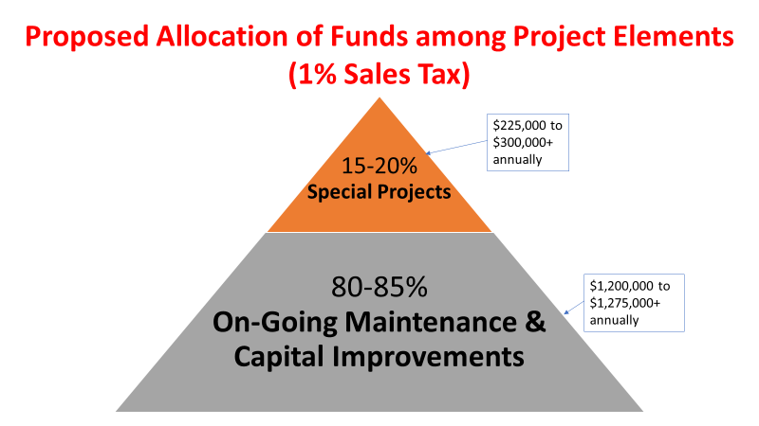

Slide 8
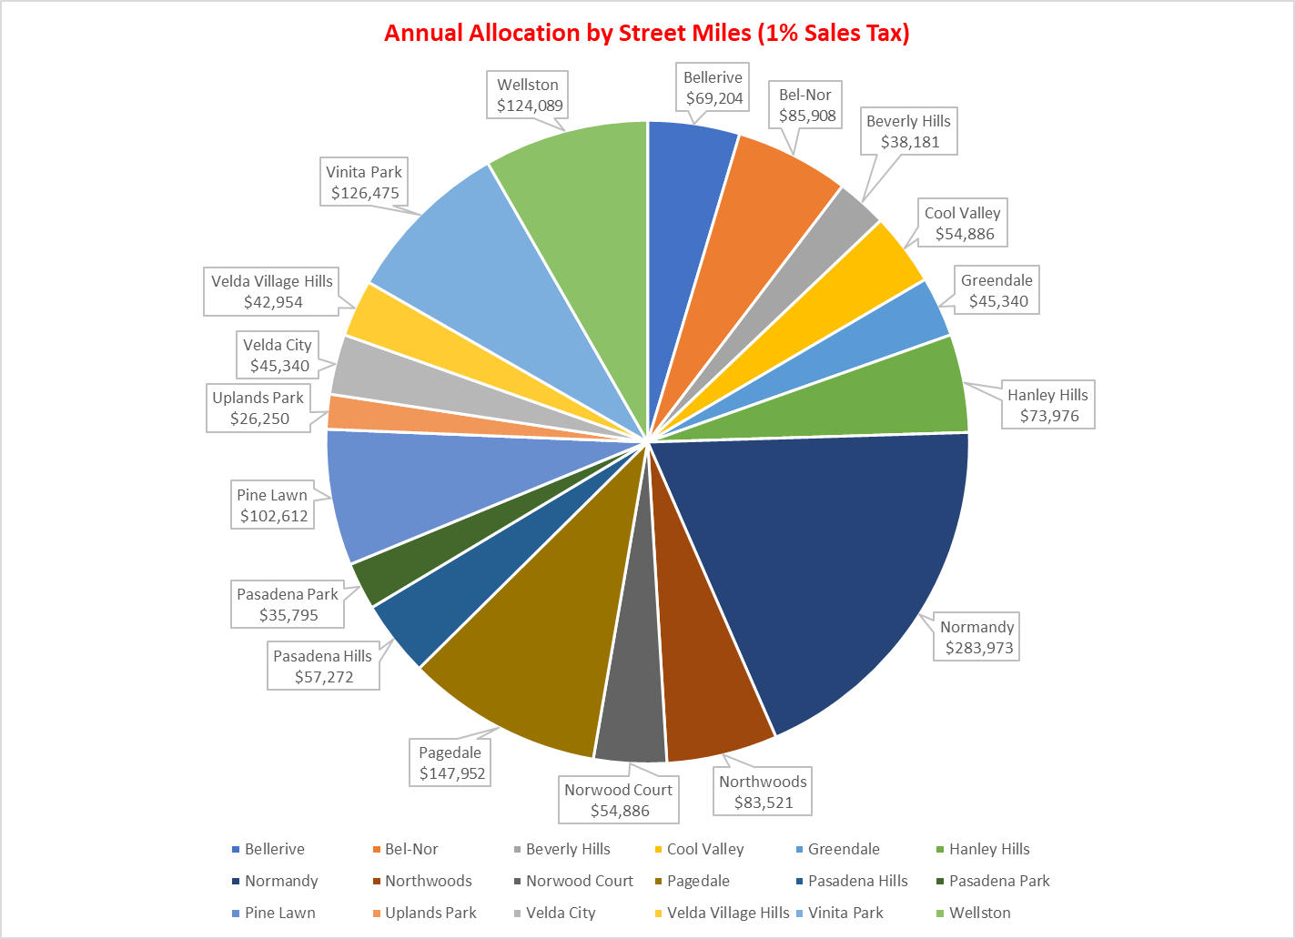

Slide 9
Next Steps
Complete the comprehensive streets survey
Engage in Community Outreach
Identify stakeholders in each city to serve as advocates
Engage in voter education, since an election will be required
Interview firms to assist with ballot campaign
Form the TDD
Each participating municipality must adopt a resolution
Participating municipalities will file a Petition with the St. Louis County Circuit Court
After a public hearing, Court will certify a ballot question for consideration by voters within the participating municipalities
Board of Directors for the TDD will consist of the presiding officer of each participating municipality

